Slide 1
Introduction to the
C
Programming Language

Slide 2
Quick History
Designed by Dennis Ritchie
Developed by him and Bell Laboratories
First appeared in 1972 (43 years old)

Slide 3
Compilers Linux and OSX
On linux: gcc and clang
clang gives better warnings and error messages in my opinion
clang -Wall main.c -o main
creates a compiled executable called main
Run with ./main

Slide 4
Compilers Windows
Visual studio C++ compiler
Visual studio 2013 is now free for all non commercial use
A bit tricky to work from the commandline

Slide 5
Computer Memory
1
2
3
4
Address
Address
Stack
Grows and shrinks
Heap
gets allocated
and freed
Address
Address
12
13
14
Address
Address
Address

Slide 6

Pointers
Is a variable that contains the memory address
of another variable.
This Pointer can contain the memory address of a value of type int

Slide 7

Get the memory address
the ‘&’ symbol in front of a variable will give you
its memory address
“intPointer” now points to the variable “getsPointedAt”.

Slide 8
Get the value a pointer points to
If you want the value the pointer points to you have to dereference it
Putting the * symbol in front dereferences the pointer and printf prints:
“Printing the value intPointer points to: 1”

Slide 9
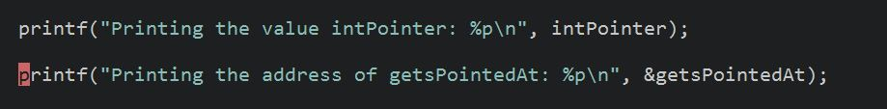
More print-outs
These two printf’s prints the same thing, the memory address of the variable “getsPointedAt” in hexadecimal
“27F42CF828”

Slide 10
Pointers and functions
Pass by reference and pass by value
If you pass the address of a variable you can change the actual value
If you pass the value, the function gets a local copy that gets destroyed when the function returns

Slide 11
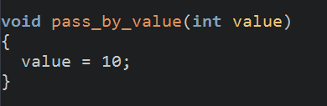
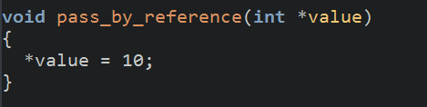
Two functions

Slide 12
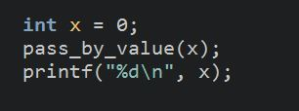

Calling both functions
Print-out: 0
Print-out: 10

Slide 13
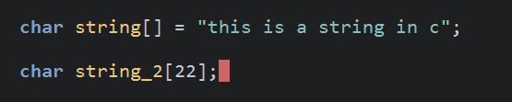
C Strings
A string is just an array of characters
Strings in C must end with a nullByte: \0 or 0

Slide 14
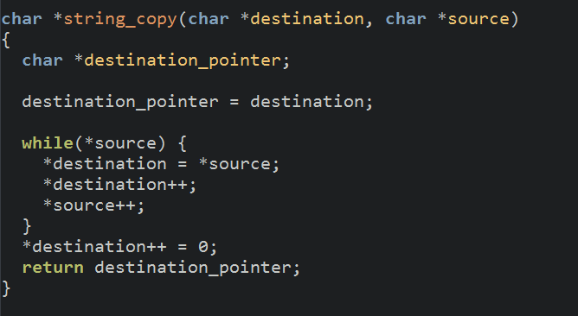
Strings and pointers
A pointer can point to the start of a string

Slide 15
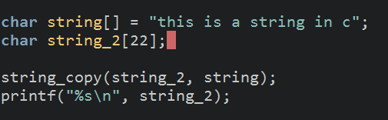
The call
Print-out: “this is a string in c”

Slide 16
Problems
What happens if the string character is too small to hold the copied string?
Make sure the buffer is always big enough, or make a new function that takes the number of bytes to be copied

Slide 17
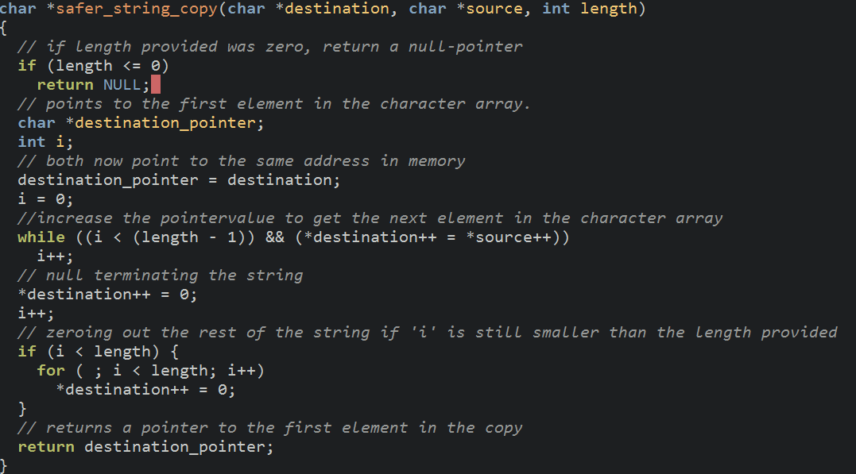
A safer string copy

Slide 18
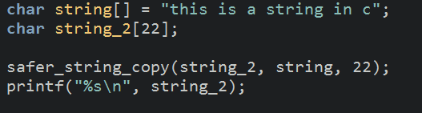
The call
Print-out: “this is a string in c”

Slide 19
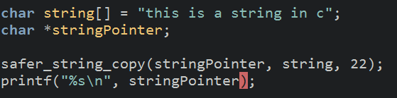
String Pointer
we said to copy 22 bytes, but the “charPointer” only points to one char (1 byte)
when we then increment the “charPointer” it will point to unallocated memory

Slide 20
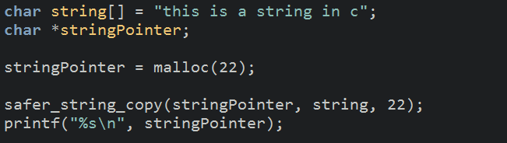
Solution, Malloc
We allocate enough bytes to the pointer

Slide 21
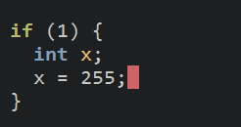
Fun with Pointers
Any variable created inside a code block can not be accessed outside the block
example:

Slide 22
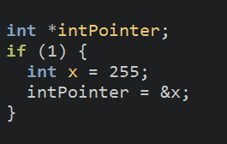
Undefined Behaviour
But with pointers we can actually get the value out (maybe).

Slide 23
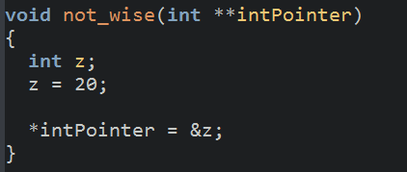
Pointer to a Pointer
But pointers to pointers are really useful if used
correctly.

Slide 24
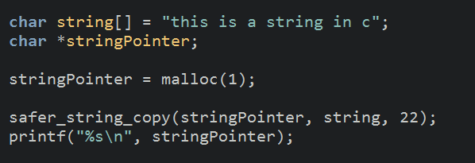
Fun with malloc
You can get wired results with malloc

Slide 25
Important things not discussed
Structs, especially struct pointers
Sizeof
Bitwise operators
Debugging

Slide 26
Github
These slides, and a well documented source will be pushed to
https://github.com/Artigmann/C_intro_TG15
Everything will be up later today!

